Slide 1
Before The Floods...
Chintan Jariwala | Param Mehta | Perikumar Javia| Sharvil ShaH CSE 578: Data Visualization

Slide 2

Presentation Contents
This power point presentation lays out what our project team has been doing and also presenting the design mockups of things that we are going to implement in the final project.

Slide 3
Project Visualization
Visualization Name | Working/ Developed | To be Developed
Selection of City and Weather Graph. | ✓ | -
Comparison of pollution index | ✓ | -
Greenhouse Gas Emission | - | ✓
Forest Data | - | ✓
CO2 Emission – By country | - | ✓
CO2 Emission – By Source | - | ✓

Slide 4
City Name
Get Weather
Visualization-1.
Pollution Index
Comparison with other countries and WHO level.
For weather information
Greenhouse gas source emission.
Forest Area on globe – by country.
CO2 emission by source and countries
Countries emitting Greenhouse gases over the years
% of forest area of total area

Slide 5
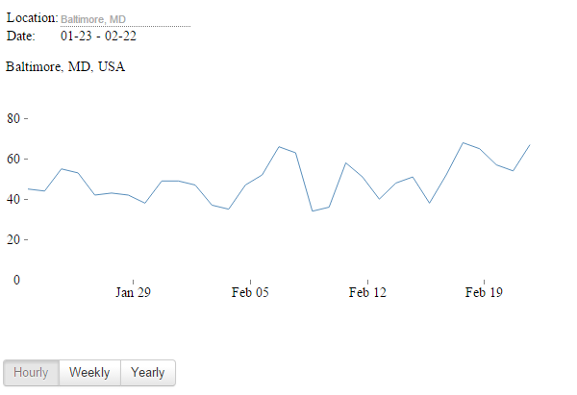
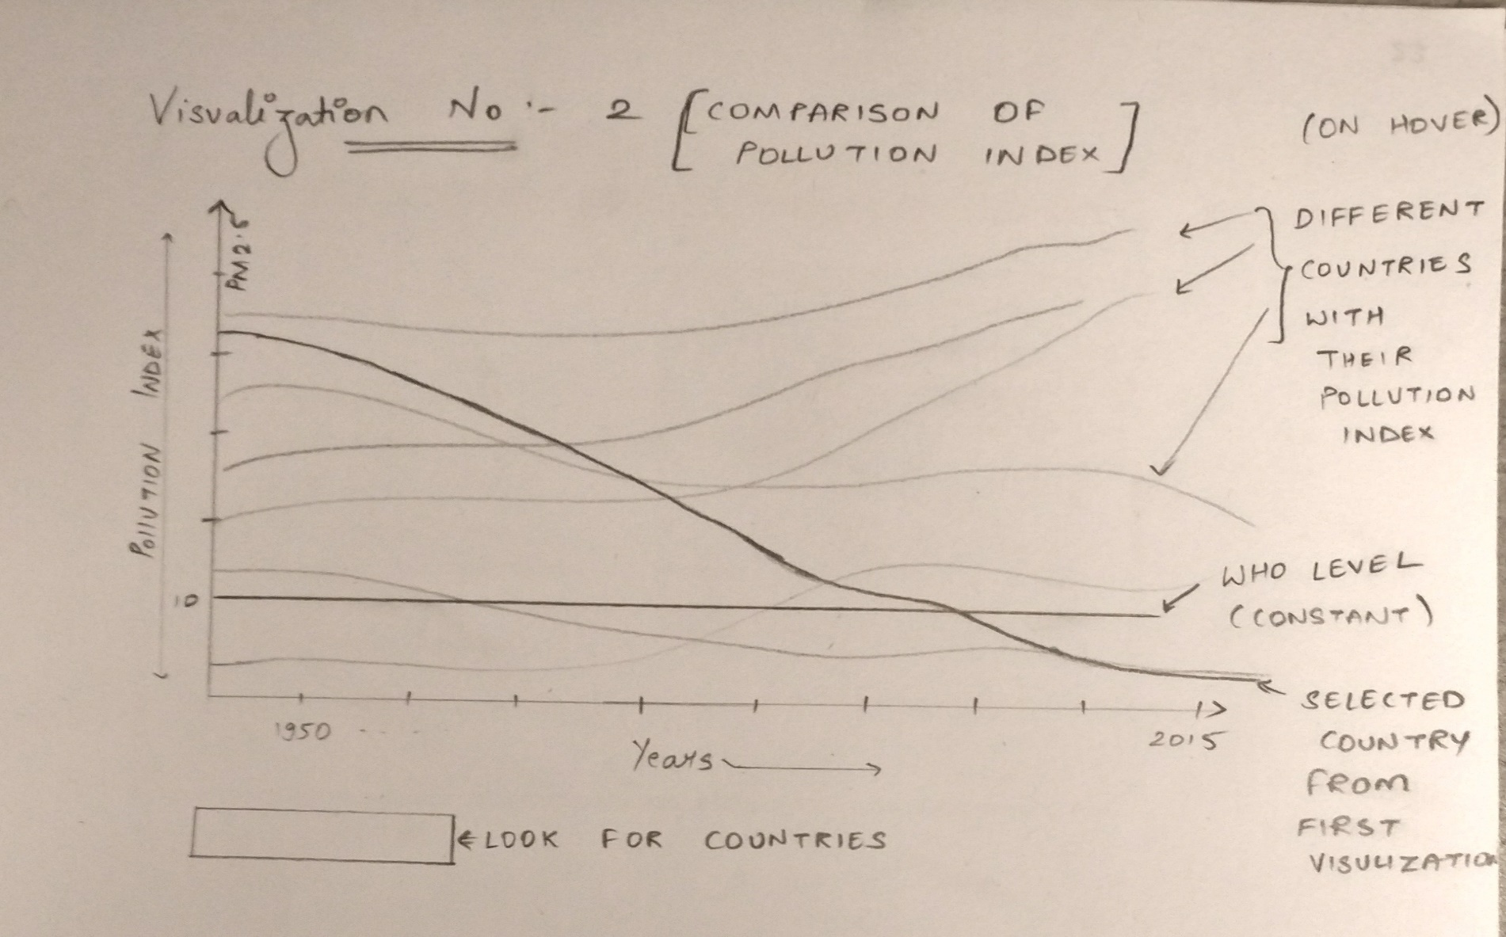
Visualization 1 : Selection of City and Weather Graph.
Source : http://bl.ocks.org/kylesb/raw/be541e2d6102900b9ed99e0d7141c13b/

Slide 6
Visualization 2 : Comparison of pollution index.

Slide 7
Visualization 3 : Greenhouse Gas Source Emission.
Source : https://www.theguardian.com/environment/ng-interactive/2014/dec/01/carbon-emissions-past-present-and-future-interactive
Notes:
Sir, This is a Gif image please view as a presentation to see through the animation.

Slide 8
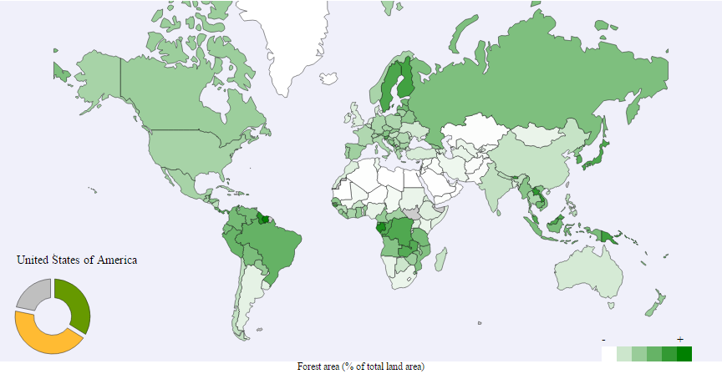
Visualization 4 : Forest Data
Source : https://bl.ocks.org/rhuille/raw/583877d1d5f82d186a87d6145055340f/

Slide 9
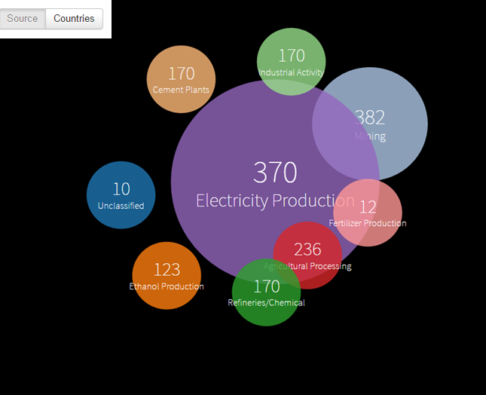
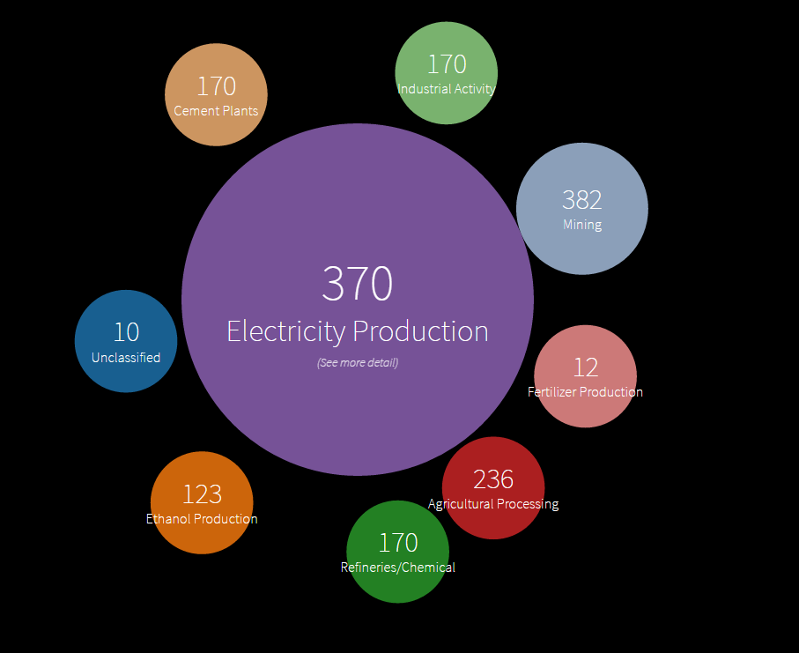
Visualization 5 : CO2 Emission - Source
Source : http://bl.ocks.org/phuonghuynh/raw/54a2f97950feadb45b07/

Slide 10
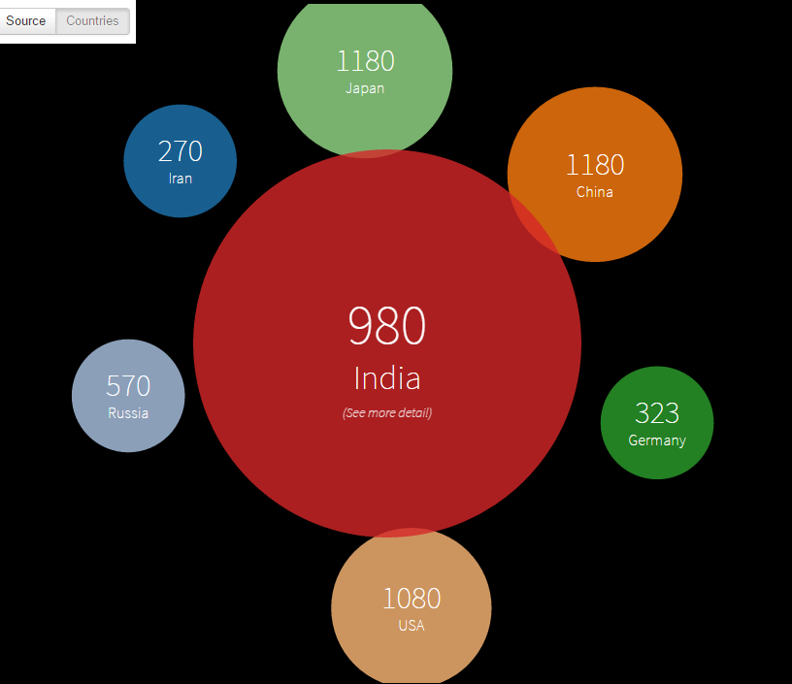
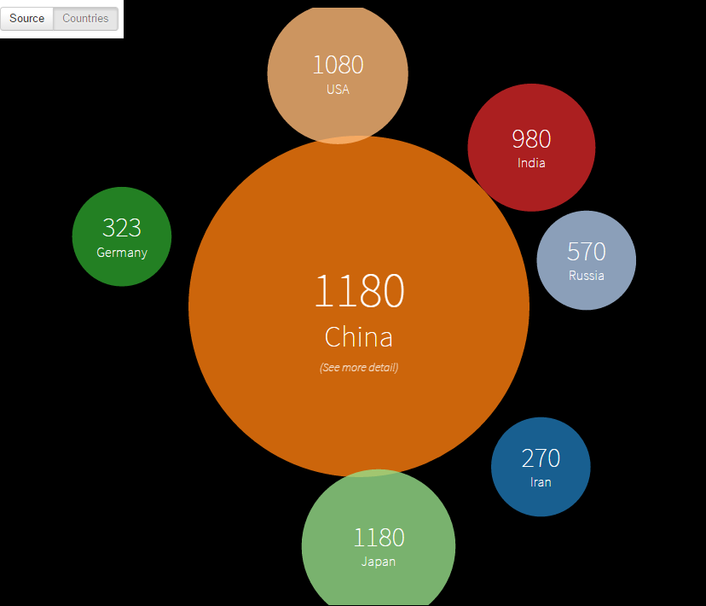
Visualization 6 : CO2 Emission - Country
Source : http://bl.ocks.org/phuonghuynh/raw/54a2f97950feadb45b07/

Slide 11
Thank you

